Slide 1

PRACTICE PROBLEMS BASED ON CONVERTING ER DIAGRAM TO TABLES-
Department of Computer Engineering and Applications

Slide 2
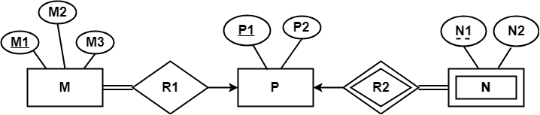
Problem-01: Find the minimum number of tables required for the following ER diagram in relational model-
Applying the rules, minimum 3 tables will be required-
MR1 (M1 , M2 , M3 , P1)
P (P1 , P2)
NR2 (P1 , N1 , N2)

Slide 3
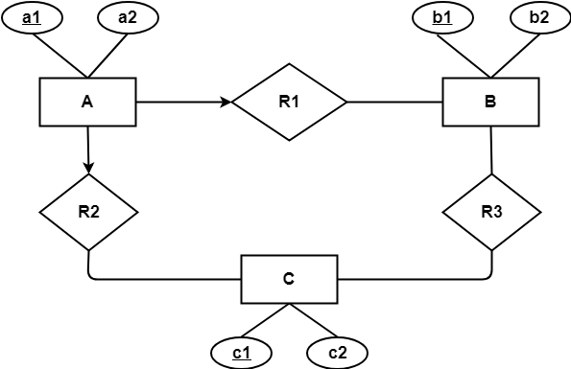
Problem-02: Find the minimum number of tables required to represent the given ER diagram in relational model

Slide 4
Solution
Applying the rules, minimum 4 tables will be required-
AR1R2 (a1 , a2 , b1 , c1)
B (b1 , b2)
C (c1 , c2)
R3 (b1 , c1)

Slide 5
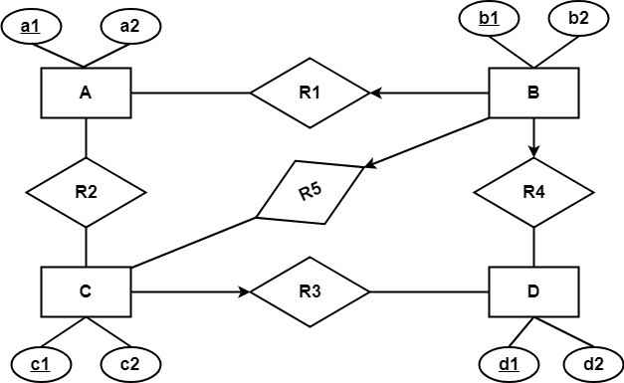
Problem-03: Find the minimum number of tables required to represent the given ER diagram in relational model

Slide 6
Solution-
Applying the rules, minimum 5 tables will be required-
BR1R4R5 (b1 , b2 , a1 , c1 , d1)
A (a1 , a2)
R2 (a1 , c1)
CR3 (c1 , c2 , d1)
D (d1 , d2)

Slide 7
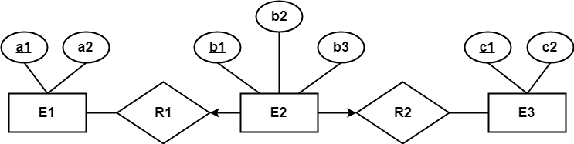
Problem-04: Find the minimum number of tables required to represent the given ER diagram in relational model-

Slide 8
Solution-
Applying the rules, minimum 3 tables will be required-
E1 (a1 , a2)
E2R1R2 (b1 , b2 , a1 , c1 , b3)
E3 (c1 , c2)

Slide 9
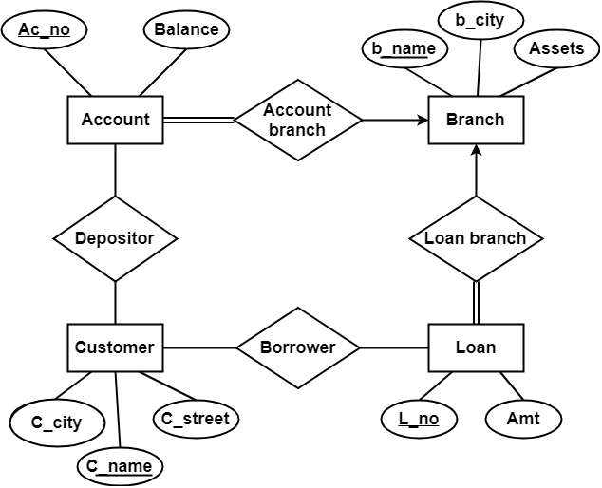
Problem-05:
Find the minimum number of tables required to represent the given ER diagram in relational model.

Slide 10
Solution-
Applying the rules that we have learnt, minimum 6 tables will be required-
Account (Ac_no , Balance , b_name)
Branch (b_name , b_city , Assets)
Loan (L_no , Amt , b_name)
Borrower (C_name , L_no)
Customer (C_name , C_street , C_city)
Depositor (C_name , Ac_no)

